Slide 2
Test Automation Project on YouTube
Team Members:
Darsh Asawa (500061595) (16)
Prakhar Aggarwal (500061466) (45)
Sajal Sood (500062540) (51)

Slide 3
OBJECTIVE
To create a automated testing project on YouTube via use of Selenium WebDriver and TestNG Framework. The sub objectives incidental to the main objectives are:
Sign in using Google account to get access to YouTube.
Using Data Providers to search multiple brand’s YouTube pages.
Play video and manipulate video (pause, skip, next).
Assertions to verify content of webpages for expected results.
Report for automated test’s results.

Slide 4
Functionalities
There are four functionality for the respected objectives:
Login
Search
Open video
Manipulate video

Slide 5
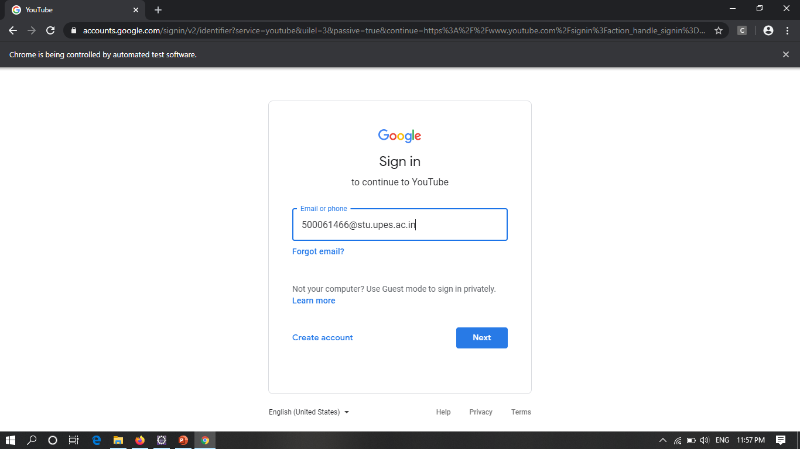
Login()
Fig 1: Entering Email

Slide 6
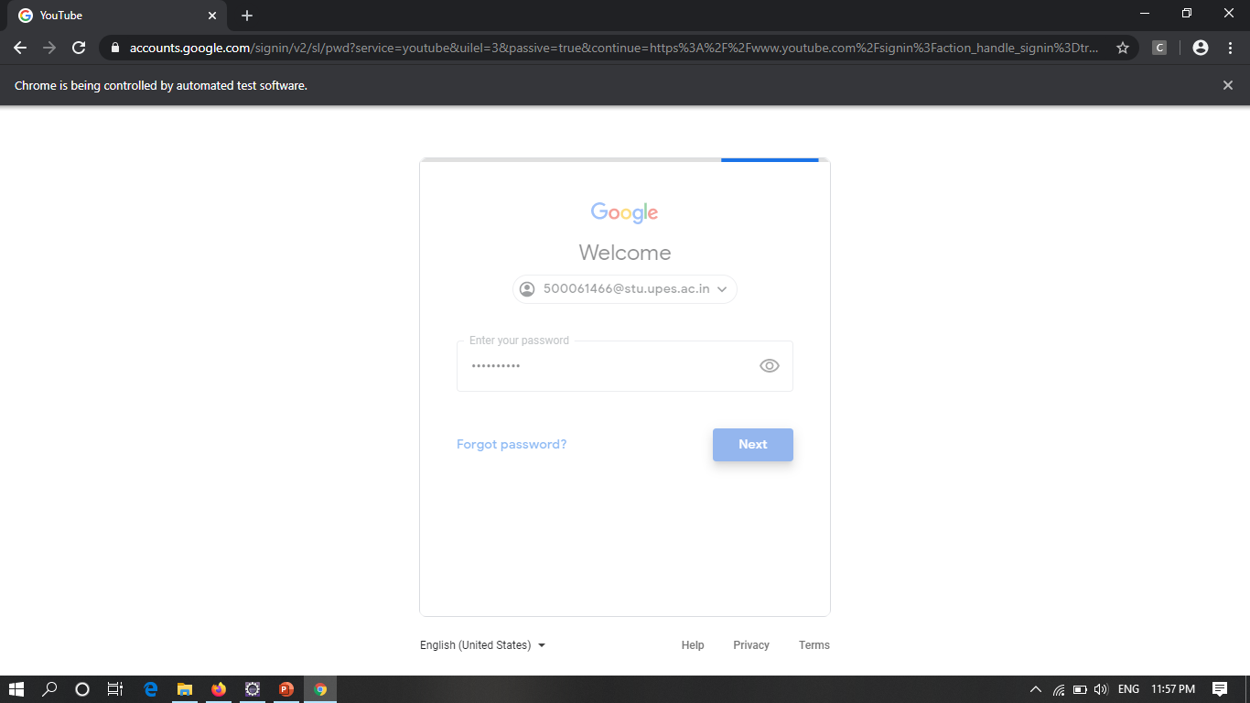
Fig 2: Entering Password

Slide 7
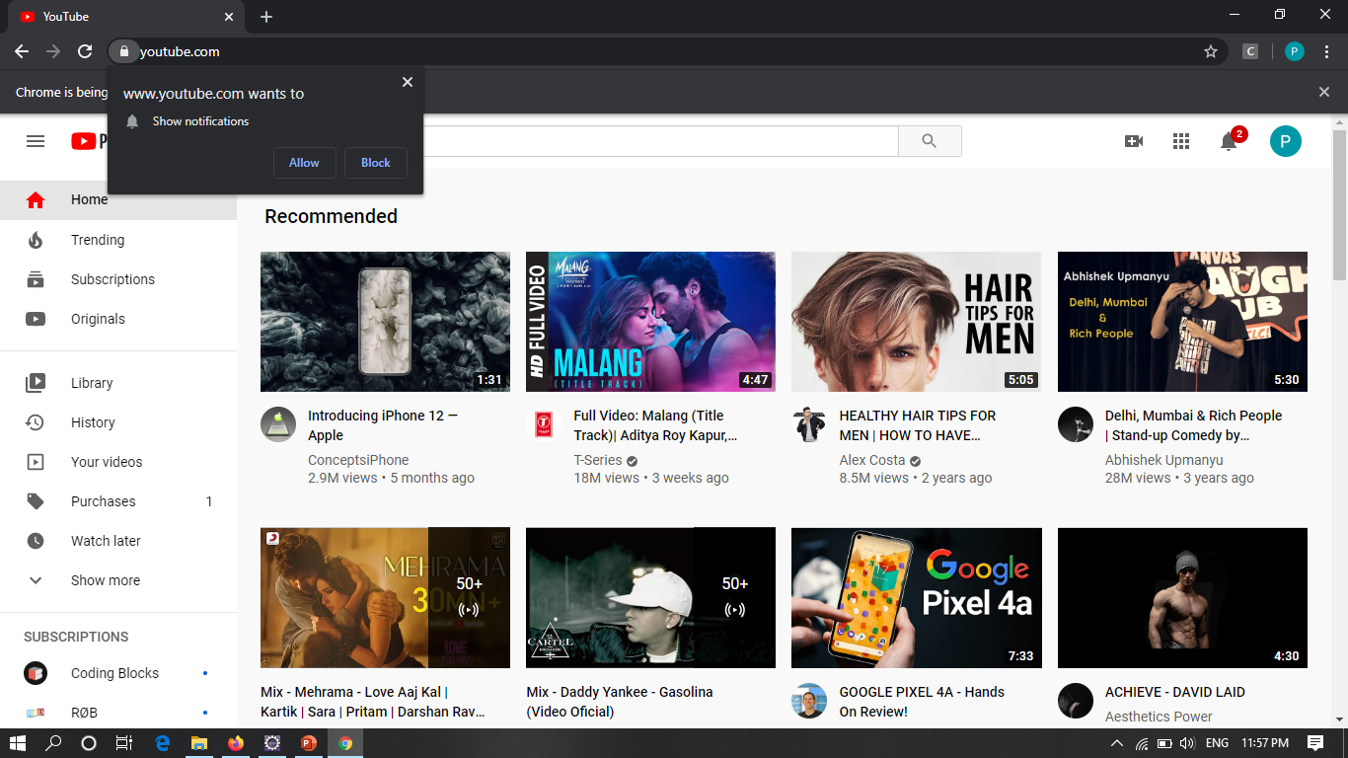
Fig 3: YouTube’s main screen after logging in

Slide 8
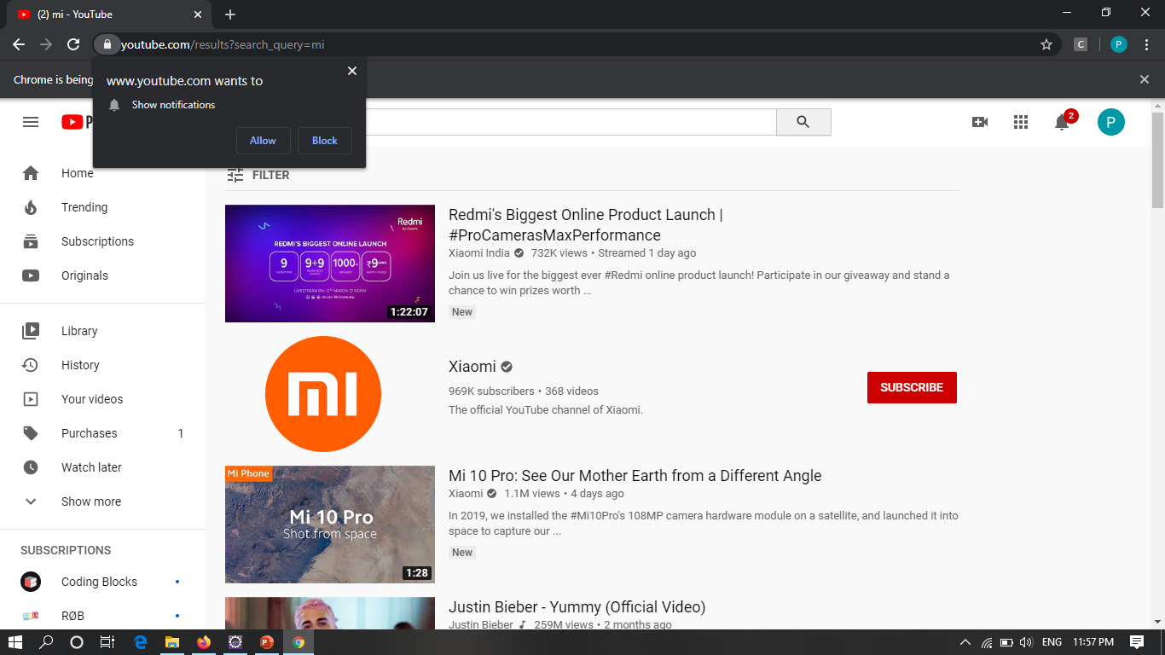
Search()
Fig 4: Searching MI as the first brand

Slide 9
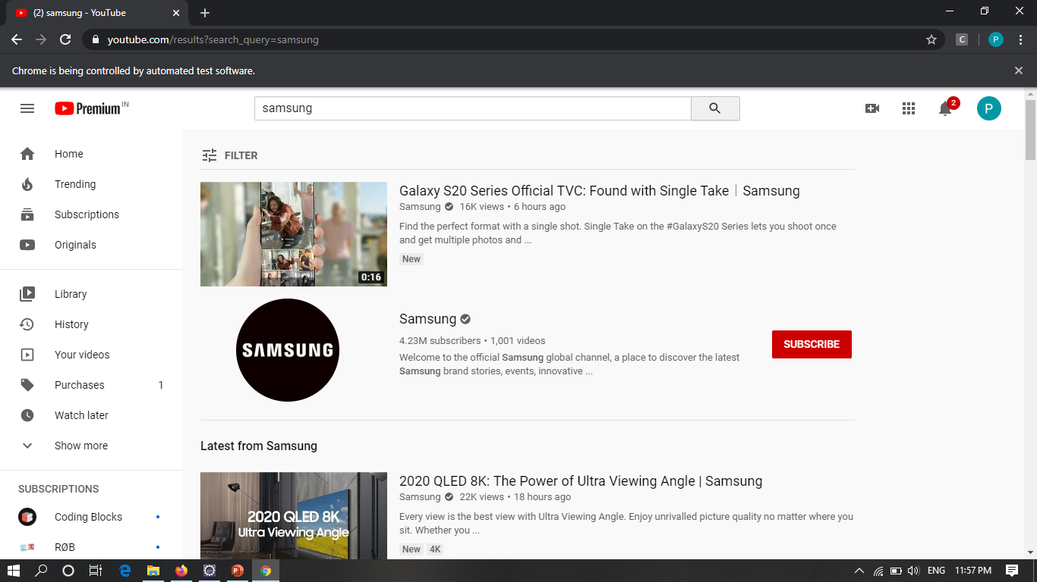
Fig 5: Searching SAMSUNG as the second brand

Slide 10
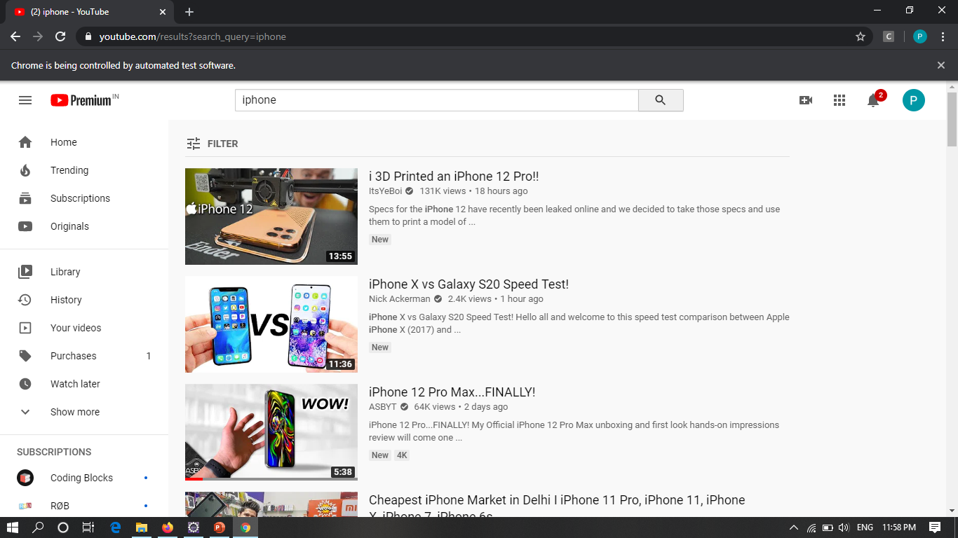
Fig 6: Searching IPHONE as the first brand

Slide 11
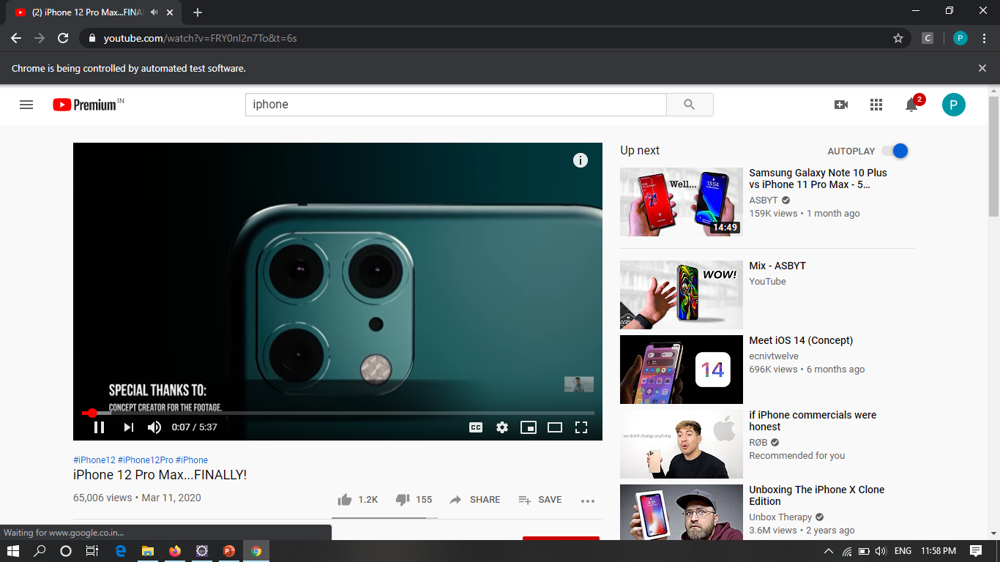
Videoopen()
Fig 7: Video played after IPHONE search.

Slide 12
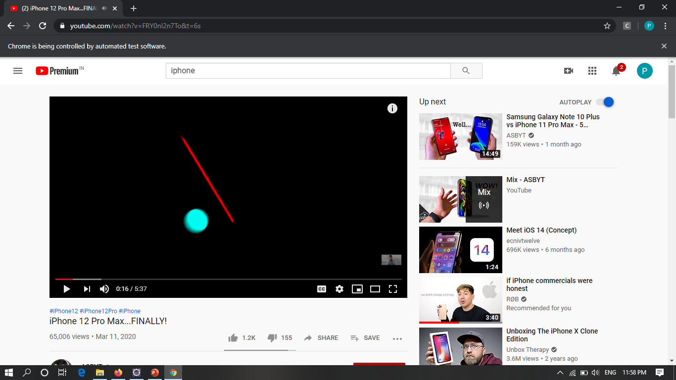
Videomanipulate()
Fig 8: Video paused and skipped for 5 seconds.

Slide 13
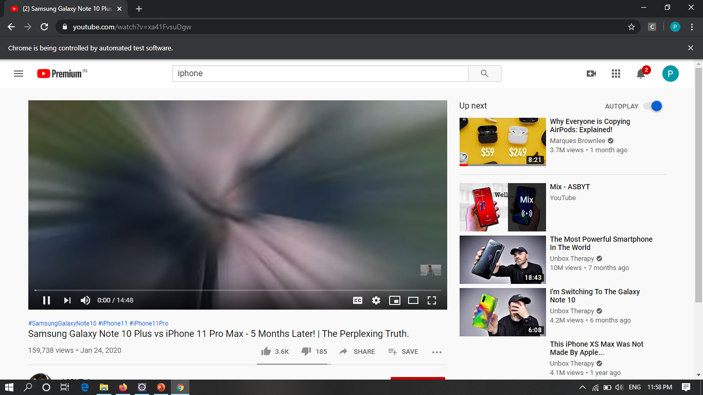
Fig 9: Played next video.

Slide 14
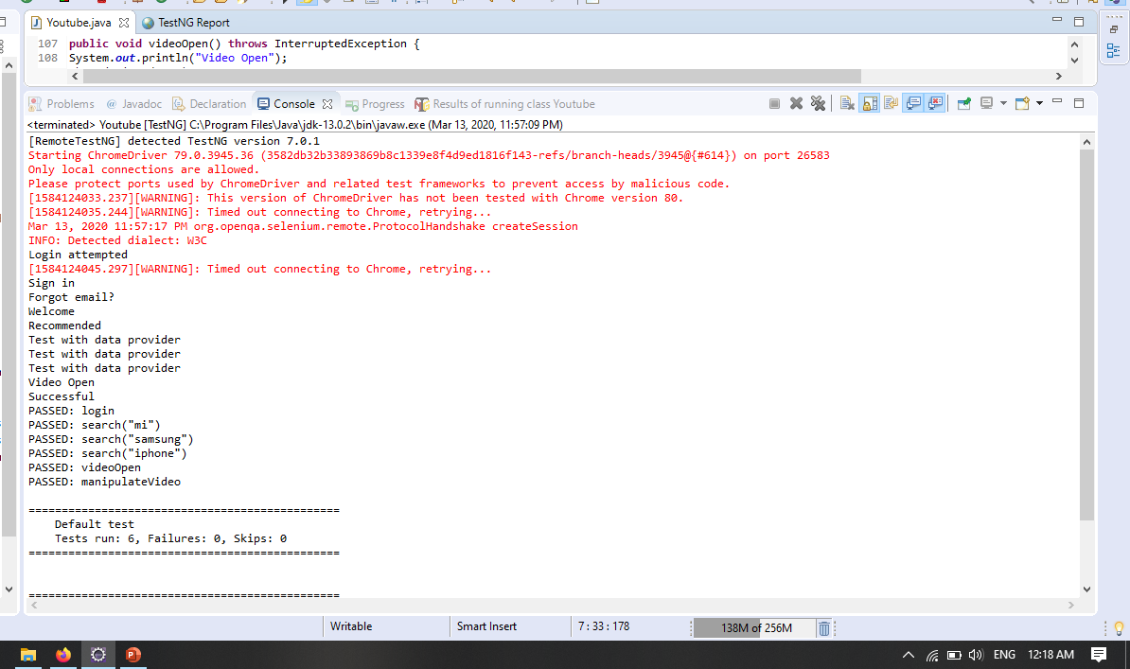
Fig 10: Console Output after execution.

